Slide 1
Programmes and Policies of Ministry of MSME, Government of India
Presented by
Shri. G.S.Prakash, IEDS
Joint Director & Head
MSME-Development Institute, Thrissur
Govt .of . India , Ministry of MSME

Slide 2
MSMEs are Micro, Small and Medium Enterprises
Micro Enterprises
Small Enterprises
Medium Enterprises

Slide 3
INDIAN MSME SECTOR
633 LAKH
111 MILLION
38% GDP
40% EXPORT
MSME UNITS
EMPLOYMENT

Slide 4
Size of MSME
INDIA 2019
633 lakh MSME Units
30% Workforce
99.4% Micro Units
111 Million Employment
8.7% Population
23.8 lakh MSME Units
99. 11% Micro Units
4. 464 Million Employment
12.9 % Population
40 % Workforce
KERALA 2019

Slide 5
OVER ALL SUPPORT SYSTEM FOR MSMEs
Central Government
MSME MINISTRY
MSME BOARD
MSME DEVELOPMENT ORGANIZATION DC (MSME) & Field Offices
Coir Board
National Small Industries Corporation (NSIC)
Khadi Village Industries Commission (KVIC)
Small Industries Development Bank of India (SIDBI)
State Government
DIRECTORATE OF INDUSTRIES & COMMERCE
DISTRICT INDUSTRIES CENTRE

Slide 6
Organizational Structure of O/o DC (MSME)
AS & DC (MSME)
MSME – DIs (30)
Br. MSME – DIs(28)
MSME – TI (2)
MSME – TCs (4)
HTDDTC
Autonomous Bodies (18)
MSME –
TS (7)
TR (10)
TDCs (8)
TCSP (15) WB

Slide 7
UP COMING 15 NEW TECHNOLOGY CENTREs UNDER TCSP
BHIWADI
DURG
BADDI
VIZAG
ROHTAK
BHOPAL
KANPUR
ERNAKULAM
Auto
Components
General
Engineering
General
Engineering
General
Engineering
General
Engineering
General
Engineering
General
Engineering
General
Engineering
General
Engineering
PATNA
SITARGANJ
GREATER NOIDA
SRIPERUMBADUR
BANGALORE
PUDUCHERRY
IMPHAL
Auto
Components
ESDM
ESDM
AUTO & AEROSPACE
ESDM
FRAGRANCE & FLAVOURS

Slide 8
MSME- Testing Centres
CHENNAI
MUMBAI
KOLKATA
NEW DELHI

Slide 9
MSME- Testing Stations
01
02
03
04
05
PONDICHERRY
HYDERABAD
BANGALORE
JAIPUR
SHOLAPUR

Slide 10
MSME Field Institutes in Kerala
MSME-Development Institute, Thrissur - is the Field Office for Kerala under the Ministry of MSME , Govt of India
NEW TECHNOLOGY CENTRE ANGAMALY ,KOCHI
Engineering facilities with precision machine tools and allied equipment,
To designs and manufacture moulds, dies, jigs, fixtures, precision parts and components etc. ,
Training programmes up to M Tech level
3) Other Offices in Kerala under M/o MSME
Small Industries Bank of India (SIDBI) at Kochi,
Khadi Village industries Commission (KVIC)
National Small Industries Corporation (NSIC) at Kochi

Slide 11
POLICY FRAME WORK

Slide 12
MSMED ACT 2006
Became operational on 2nd October 2006
Prior to 2006- Small scale Industries& Businesses
After 2006- Micro and Small Enterprises
1
Simplification of registration procedure
2
Constitution of MSME board
3
Industries replaced by enterprises
4
Credit support
5
Penalty for delayed payments.

Slide 13
Revised MSME Classification-
Composite criteria- Investment & Turnover
In case enterprise cross the criteria either of the category, it will be placed in higher category
Will not be placed in lower category unless it goes below the limit in both investment and turnover
MICRO ENTERPRISES
Investment < 1 Cr & Turnover < 5 Cr
1
SMALL ENTERPRISES
Investment
< 10 Cr
& Turnover
< 50 Cr
2
MEDIUM ENTERPRISES
Investment < 50 Cr & Turnover < 250 Cr
3
With effect from July 1,2020; Exports will not form part of the Annual Turnover

Slide 14
NEW MSME REGISTRATION
MSME Registration process is known As “UDYAM REGISTRATION”
Registration Portal: www.udyamregistration.gov.in
This is in force w.e.f. 1st July 2020
Who can Register?
(1)New Registration: Entrepreneurs who are not yet registered as MSME
(2)Re-registration: Existing entrepreneurs already having registration as EM-II / UAM (Last date was 31.12.2021)
Beware of Fake Registration sites!!! Projecting as Govt. websites!!

Slide 15
Calculation of investment in Plant & Machinery or equipment
Existing enterprise where ITR for the FY is filed
The calculation of investment will be based on the ITR of the FY filed under the IT act 1961
New enterprise where no prior ITR is available
The calculation of investment will be based on the self-declaration of the promoter of the enterprise. Such relaxation shall end after the 31st March of the FY in which files its first ITR
New enterprise where no prior ITR is available
Under self-declaration, the invoice value of P&M or equipment, whether purchased first hand or second hand, shall be taken into account excluding GST.

Slide 16
Enterprises which have PAN
Information regarding Turnover shall be linked to the IT Act or the CGST Act and the GSTIN
Calculation of Turnover
Enterprises which do not have PAN
The turnover related figures will be considered on self-declaration basis for a period up to 31st March, 2021. After 31st March, 2021 PAN is made mandatory

Slide 17
Clarification regarding Financial Year in respect of the data of Investment, Turnover and Export from the IT Department and GSTN for effecting the Classification of MSMEs -reg.
Financial Year of Registration in Udyam Portal | Data (Investment, Turnover and Export) taken or to be and classification as MSMEs taken from IT Department and GSTN from the relevant Financial Year
2020-21 | 2018-19
2021-22 | 2019-20
2022-23 | 2020-21

Slide 18
Benefits of Udyam Registration:
It will be a permanent registration and basic identification number for an enterprise.
Along with the Udyam Registration, Enterprises may register themselves on GeM (Government e-Market place, a portal for G to B) & SAMADHAAN Portal (a portal to address issues relating to delay in payments)
MSMEs can also on board on TReDS Platform,(the invoices of receivables are traded on this platform)
MSMEs can avail the benefits of Schemes of Ministry of MSME such as Credit Guarantee Scheme, Public Procurement Policy, additional edge in Government Tenders & Protection against delayed payments etc.
Becomes eligible for priority sector lending from Banks.

Slide 19
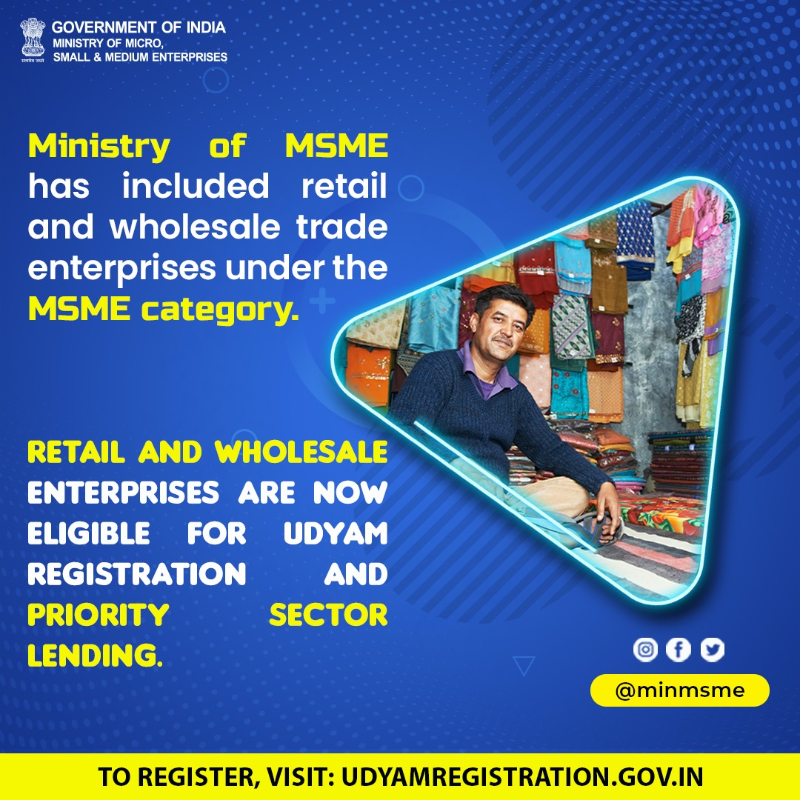

Slide 20
The Ministry of Micro, Small & Medium Enterprises (MSME) on August 9, 2021 has issued the Inclusion of urban street vendors in MSME category. It is clarified that the Street Vendors can register as retail trades on Udyam Registration (UR) portal.
The benefits to Retail and Wholesale trade MSMEs are to be restricted to Priority Sector Lending only.
The list of eligible additional activities under NIC Code 45,46 and 47 are as follows: -
• 45 Wholesale and retail trade and repair of motor vehicle and motorcycles
• 46 Wholesale trade except of motor vehicles and motor cycles
• 47 Retail Trade Except of Motor Vehicles and motor cycles

Slide 21
Public Procurement Policy (PPP)
01
EMD Exemption, Free tender document and Price Preference
03
All enterprises registered
with Udyam Registration
05
Minimum 25% to be procured annually by Central Ministry/Department/ Central PSUs from MSEs
A sub-target of 4% of procurement from SC / ST owned MSEs.
3% for women enterprises
02
04
Preferred Price band of L1 + 15% to MSE’s
“Works contract” not covered under Public Procurement Policy

Slide 22
358 items continue to be reserved for exclusive purchase from MSEs.
Defense armament imports / weapon systems, missiles, etc exempted from purview of this policy .
(Due to its unique nature )
22
Beneficiaries
All enterprises registered with any of the following :
Micro and Small Enterprises (as per MSMED act) ; Khadi, Village Industries Commission; Coir board ;
Khadi and Village Industries Board ; NSIC registered units; Directorate of Handicrafts and Handloom ;
Any other body specified by Ministry of MSME; With effect from 18.09.2015, MSEs registered under UAM/UR are also eligible to avail the benefits under Policy.

Slide 23
Contd…..
Benefits under PPP
MSEs will be facilitated by tender sets free of cost
Exempting MSEs from payment of earnest money
Adopting e-procurement to bring in transparency in tendering process
358items are reserved for exclusive procurement from MSE’s

Slide 24
OTHER IMPORTANT POINTS
24
PPP is not applicable to traders.
The works contract is not covered under PPP.
The policy does not provide benefit for exemption from Security Deposit.
The PPP 2012 is applicable only to Central Ministries/Departments/CPSUs
Policy is applicable to all the Govt Ministries/ Departments/CPSUs irrespective of volume and nature of procurement and is not exempted from policy those having meagre value of total procurement
Installation of any object falls under service category and may avail the benefits of PPP.

Slide 25
25

Slide 26
Preference to “Make in India”
(DPIIT Order No:- P-45021/2/2017-B.E.-II Dated 16th September, 2020)

Slide 27
PREFERENCE TO MAKE IN INDIA
“Public Procurement (Preference to Make in India), Order 2017”
(Dated 16th September 2020)
As per the Order, procuring entities should not impose restrictive tender conditions that discriminate against domestic manufacturers
Categories of Goods/Services suppliers
Class I Supplier – 50% or more local content
Class II Supplier- 20% - 50% local content
Non local Supplier- 20% or less local content
As per PPMII- Government will give preference to Class 1 suppliers
Without special approval, Govt will not issue global tender enquiry for purchases of less than Rs. 200 Crore
Only suppliers with more than 20% local content can participate in such bidding process.

Slide 28
Central Public Procurement Portal
It is a single point access to the information on procurements made across various Ministries and the line Departments.
URL https://eprocure.gov.in
Platform for publication of tender and bid award details by Central and State Government Ministries, Departments and Organizations, PSUs and PSBs
The system can be adopted for all kinds of procurement such as Goods, Services & Works.

Slide 29
Government – E- Marketplace (GeM)
www.gem.gov.in

Slide 30
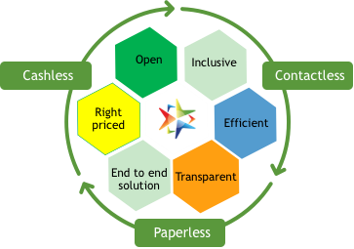
Government e Marketplace – The Genesis
A one-stop online procurement portal for all Government Buyers including Central/State ministries, Departments, Bodies & PSUs. Launched on 9th August 2016. (https://www.gem.gov.in/).
Rule 149 of GFR amended to “Procurement of Goods and Services by Ministries or Department will be mandatory for Goods or Services available on GeM”
GeM aims to enhance efficiency, transparency, inclusiveness in public procurement.
It provides the tools of e-Bidding, Reverse Auction and Direct Procurement to facilitate Government users achieve the best value for their money.
The government is committed to curbing corruption. One of the key aspects of this objective is to minimize Governments human transactional interface.

Slide 31
Challenges faced by MSMEs
Reasons for inadequate finance to MSMEs
High risk perception
Inadequate collateral
High cost of acquisition / serving
Lack of formal financial documentation
The Trade Receivables Discounting System/platform aims to bridge the financing gap between MSMEs and formal credit institutions
*According to IFC MSME report, 2012

Slide 32
Trade Receivables Discounting System (TReDS)
What is TReDS?
TReDS an electronic platform for facilitating the financing / discounting of trade receivables of Micro, Small and Medium Enterprises (MSMEs) through multiple financiers.
What is the need for TReDS?
MSMEs play an important role in the economic fabric of the country. However, they face constraints in obtaining adequate finance, particularly in terms of their ability to convert their trade receivables into liquid funds. Moreover, this is a pan-India issue. TReDS has been brought in to help ease this pain endured by MSMEs.

Slide 33
Who can participate?
Sellers
Financiers
Participants
Buyers
Only MSMEs allowed
- Banks, NBFC and other financial institutions as permitted by the Reserve Bank of India (RBI)
Government Departments, PSUs, Corporates and any other entity

Slide 34
TReDS platform brings MSMEs, their buyers and financiers on a single platform
Buyer
Buys good from seller and has to pay at the end of the credit period
TReDS Platform
TReDS platform enables buyers to accept invoices uploaded by sellers
TReDS platform settles repayment from buyer to financier
TReDS platform enables financiers to buy invoices from sellers and also settles the payment from financier to seller
Seller
Financier
Provides goods / services to large buyers and raises invoice on buyer for payment after credit period
“Buys” seller’s invoices and assumes ownership of receivables to be paid by buyer on due date

Slide 35
Trade Receivables Discounting System (TReDS)
"MSME Units are requested to Onboard on TReDS Platform.
Three available platforms are
1. www.rxil.in
2. www.m1xchange.com
3. www.invoicemart.com

Slide 36
Delayed Payment Act for MSEs
Under MSMED Act -2006, protections are offered for timely payment of goods and services by the buyers to MSEs.
• State govt. has established a Micro and Small Enterprises Facilitation Council (MSEFC) under the chairmanship of Commissioner of Industries, GOK, with the representatives from Industry Associations, Banks, etc.
• In case of delay in payments beyond 45 days, the MSE may approach the Council for dispute resolution, in accordance with the sections 15 to 24 of MSME Act, 2006.

Slide 37
Nature of assistance
Where any Buyer fails to make payment to MSE on their supplied Goods or Services, is liable to pay compound interest with monthly rests on the amount from the appointed day or immediately following the date agreed upon at three times of the bank rate notified by the RBI.

Slide 38
samadhaan.msme.gov.in
An initiative for filing online application by the supplier MSE unit against the buyer of goods/services before the concerned MSEFC of his/her State/UT.
These will be viewed by MSEFC Council for their actions.
These will be also visible to Concerned Central Ministries, Departments, CPSEs, State Government, etc. for pro-active actions.

Slide 39
Marketing Support Schemes

Slide 40
PROCUREMENT & MARKETING SUPPORT SCHEME
Participation of individual MSEs in domestic trade fairs/ exhibitions across the country
80% space rent for General and 100% for SC/ST/Women/PH/
From Rs.80000/- to Max up to Rs. 1.5 Lakhs
Capacity building of MSMEs in modern packaging technique:
80 % of cost will be paid to empanelled agency/ packaging consultant for Gen; 100% for SC/ST/W/PH limited to Rs. 1.5 lakhs for Green Packaging and Rs. 1 lakhs for ordinary packaging.
Organizing State Level/ National Level Vendor Development Programme.
Organizing/Participation in trade fairs / exhibitions by Ministry of MSME
Participating units will be provided stalls at 80% subsidy and 100% for SC/ST/Women/PH
International/
National Seminars

Slide 41
International Co-operation
Visit of MSME delegations in international exhibitions/ trade fairs, conferences/ summits/workshops etc
Holding international conferences/ summits/ workshops/ seminars to be organized in India by the Industry Associations/ Government organizations.
Participation of MSME delegations in International exhibitions, trade fairs and buyer-seller meets in foreign countries/ resource persons
IC Scheme have following three sub-components:
1. Market Development Assistance (MDA) - (both Physical and Virtual Mode)
2. Capacity Building of First Time Exporters (CBFTE)
3. Framework for International Market Intelligence Dissemination (IMID)

Slide 42
MSME MART (initiative by NSIC)
A global business to Business portal facilitating business services to MSMEs through digital interventions
Create your company’s webpage in minutes.
Keywords based unlimited tender alert
Display products & services 24 x 7
Trade leads
Connect with buyers and suppliers
Request for quotation
Information on Events and Exhibitions

Slide 43
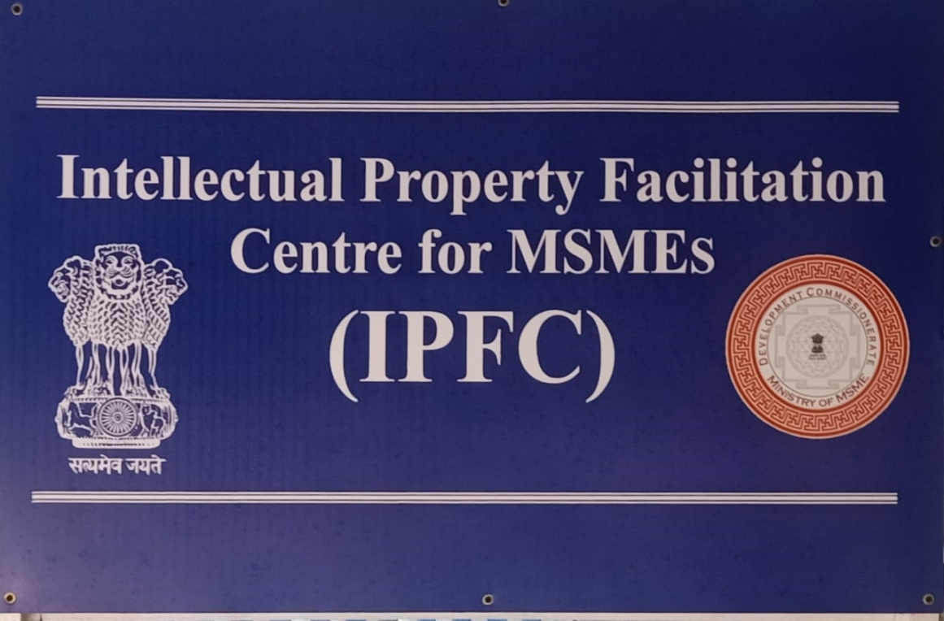
IPFC set up in MSME-DI, Thrissur
Services offered
General information and guidance on all forms of IPRs like patents, trademarks, designs, GIs etc.
Status check of existing patents ie; whether a patent is valid, abandoned or expired.
Prior art search to know the already existing knowledge on technology domain

Slide 44
Various Credit measures available for MSME Sector

Slide 45
Collateral Free Loan- CGTMSE
All fund (term loan, working capital)/ non-fund based (letter of credit/bank guarantee) facilities covered.
MSE loans for projects up to Rs. 2 crore ( as per scheme guidelines), which are not backed with collateral and third party guarantee
Guarantee is given to Member Lending Institutions (MLI)
Both Manufacturing, Service sectors & retail trade are covered.
Credit for educational / training institutions and SHGs are not eligible for coverage.
For more details www.cgtmse.in

Slide 46
Debt restructuring for MSMEs
As per the existing RBI Guidelines banks and financial institutions satisfying the following conditions shall be permitted to restructure their MSME debts:
If the total borrowings from all banks and NBFCs by the borrower does not exceed Rs 50 crores.
01
03
MSME accounts that hold a status of “standard asset” in the books as on 31st March 2021
More than 5 lakh MSME accounts already restructured and Govt expects another 25 lakh accounts to be restructured
02
FM announced to give a further extension to the scheme for MSMEs till 31st March 2022

Slide 47
EMERGENCY CREDIT LINE GUARANTEE SCHEME (ECLGS)
ECLGS
1.0
100% guarantee with respect to loans to borrowers having credit outstanding of Rs.50 crores and days past due of up to 60 days as on 29/02/2020
ECLGS
2.0
100% guarantee with respect to loans to borrowers belonging to identified sectors and healthcare sector having credit outstanding between Rs.50 crores – Rs.500 crores and days past due of up to 30 days as on 29/02/2020
ECLGS
100% guarantee with respect to loans to borrowers in the hospitality, travel & tourism, leisure & sporting and civil aviation sectors having days past due of up to 60 days as on 29/02/2020
ECLGS
3.0
ECLGS
4.0
100% guarantee with respect to loans to borrowers in eligible hospitals/nursing homes/ clinics/ medical colleges/ units engaged in manufacturing of liquid oxygen, oxygen cylinders etc. for setting up of on-site oxygen producing plants.

Slide 48
Nature of Facility:
Under ECLGS 1.0 & 3.0
Working Capital Term Loan
Under ECLGS 2.0 & 4.0
Working Capital Term Loan
Non fund based facility
Combination of both fund & non- fund

Slide 49
Quantum of Finance
ECLGS
1.0
20% of total credit outstanding up to Rs.50 crores as on 29/02/2020
ECLGS
2.0
20% of total credit outstanding up to Rs.500 crores as on 29/02/2020
ECLGS
40% of total credit outstanding subject to a cap of Rs.200 crore per borrower
ECLGS
3.0
ECLGS
4.0
Maximum 2 crore per borrower

Slide 50
Tenure
ECLGS
1.0
4 years from the date of first disbursement
ECLGS
2.0
5 years from the date of first disbursement of fund based facility or first date of utilization of non fund based facility, whichever is earlier
ECLGS
6 years from the date of first disbursement
ECLGS
3.0
ECLGS
4.0
5 years from the date of first disbursement of fund based facility or first date of utilization of non fund based facility, whichever is earlier

Slide 51
Rate of Interest
For ECLGS 1.0, ECLGS 2.0 & ECLGS 3.0
MSMEs
Linked to RLLR, subject to a minimum RoI of 7.5% and maximum up to 9.25%
ECLGS 4.0
Linked to RLR/ MCLR with maximum cap at 7.5% pa
Interest to be served as and when applied
Penal interest as per extant bank’s guidelines would be charged for default in payment of installments & interest within stipulated time period
No penal interest due to any non-compliance of the already accepted covenants on existing credit facilities may be charged on this product during the sanction time

Slide 52
Asset Restructuring Module for MSME (ARM-MSME)
Asset Restructuring Module for MSME (ARM-MSME) is a web-based Do It Yourself (DIY) module to help MSME entrepreneur(s) prepare restructuring proposal themselves and submit to their bank(s).
It is a web portal developed by Small Industries Development Bank of India (SIDBI) and its associate, India SME Asset Reconstruction Company Ltd. (ISARC).
Web portal of ARM-MSME can be accessed from https://arm-msme.in

Slide 53
Subordinate Debt for Stressed MSMEs (CGSSD ) https://subdebt.cgtmse.in/SUBDEBT/jsp/Home.jsp
To provide Sub-debt support in respect of restructuring of MSMEs
Repayment tenure- 10 years
Moratorium on payment of principal is 7 years
MSME promoters will be provided credit equal to 15% of their stake or Rs.75 lakh, whichever is lower
Scheme validity extended up to 30/09/2021
Eligible borrowers-
1) MSME Accounts which are Stressed (SMA 2 and NPA) as on 30.04.2020
2) MSMEs whose accounts have been Standard as on 31.03.2018
3) MSME should be in Operation either as Standard Accounts or NPA during FY 2018-19 & 2019-20

Slide 54
Infrastructure Development

Slide 55
MSE-CLUSTER DEVELOPMENT
A cluster is a group of enterprises located within an identifiable and as far as practicable, contiguous area or a value chain that goes beyond a geographical area and producing same / similar products / complementary products/ services, which can be linked together by common physical infrastructure facilities that helps them to address their common challenges.

Slide 56
Components
Common Facility Centers: Creation of “tangible assets” such as Common Production / Processing Centre, Design Centers, Testing Facilities including Plug & Play Facilities with Backward / Forward Linkages etc. GoI grant - 70% of the project cost (Max 20 Cr)
Infrastructure Development: Development of land, roads, drainage, power distribution etc. in new / existing industrial (multi-product) areas / estates / Flatted Factory Complex GoI grant - 60% of the Project cost Project cost not exceeding Rs.10 cr. for IE and Rs.15 Cr for FFC
.

Slide 57
Other Schemes by Government of India

Slide 58
Pradhan Mantri MUDRA Yojana (PMMY)
01
Scheme launched by the Hon’ble Prime Minister on April 8, 2015
02
Loans up to 10 lakh to the non-corporate, non-farm small/micro enterprises
03
Loans are given by Commercial Banks, RRBs, Small Finance Banks, MFIs and NBFCs.
You can simply impress your audience and add a unique zing and appeal to your Presentations.

Slide 59
Stand-up India
The entrepreneur may be engaged in manufacturing, services or the trading sector.
Bank loans between Rs 10 lakh and Rs 1 Crore
5
To promote entrepreneurship amongst the schedule caste /schedule tribe and women
3
1
6
4
Composite loan of 75% of the project cost inclusive of term loan and working capital.
Loans under the scheme is available for only Green field Projects
2
To provide handholding support to potential entrepreneurs

Slide 60
PSB Loans in 59 minutes
An online marketplace to cater to various financial aspirations of individuals and businesses.
The Platform is processing loan applications for In-principle approval within 59 minutes.
Platform is integrated with CGTMSE to check eligibility of borrowers)
Borrower gets an In-principle approval letter in less than 59 minutes
Rate of interest starts from 8.5%
Unique platform that ensures seamless In-principle loan approval
Business Loan In-principle approvals, with /without collateral, are currently provided for value from INR 1 Lac to INR 5 Crore
PSB Loans
Post receiving In-principle approval letter, the loan is expected to be sanctioned/ disbursed in around 7-8 working days
The borrower has been given the flexibility to choose lender

Slide 61
UDYAMIMITRA
A credit delivery platform enabling ease of access to MSMEs financial and non-financial service needs

Slide 62
National Small Industries Corporation

Slide 63
Schemes offered by NSIC
Procurement & Marketing Support
National SC/ST Hub
Exhibition & Event Management
Credit Support
Infrastructure
Marketing Support

Slide 64
For more details visit:
Manager
NSIC LTD, S-67,GCDA COMMERCIAL COMPLEX, MARINE DRIVE,SHANMUGHAM ROAD, KOCHI-682031 Zip Code -682031
Ph- 0484-2381850/2368149 Fax- 0484-2380155 Email: bococh@nsic.co.in

Slide 65
SIDBI ( Small Industries Development Bank )
T BALAJI
AGM
9786630641
tbalaji@sidbi.in
Kochi BO - M T Plaza, Ground floor, 64/2842, Kaloor-Kadavanthara Road, Kochi - 682017 Kerala, INDIA Tel No : 0484-4025313, 4030313, 4028313

Slide 66
General Services/ Grievances

Slide 67
Redressal Portal
State Control Room- 0487-2953300

Slide 68
MSME-Development Institute , Thrissur Kanjani Road, Ayyanthole P:O Thrissur-680003 Tel: 0487-2360536, 0487-2360216 Email: dcdi-thrissur@dcmsme.gov.in www.msmedithrissur.gov.in State Champions Control Room- 0487-2953300 www.champions.gov.in

Slide 69
Thank you
THANK YOU

